Slide 1
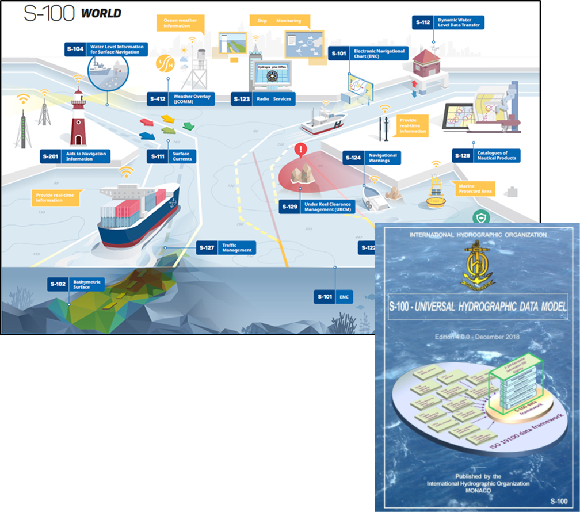
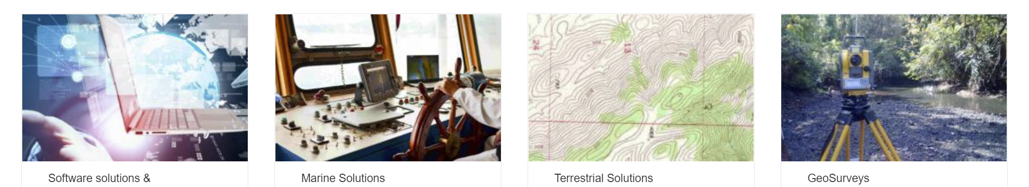

IIC Technologies
IIC Technologies provides solutions and services for the acquisition, management, integration and dissemination of geospatial data.
Global Presence – Clients in over 30 countries
End-to-end geospatial solutions to the Aeronautics, Defense, Government, Infrastructure, Marine, Oil & Gas, Transportation and Utility sectors.
Marine Sector.
Production of Marine Charts and publications data for Navigation
Consultants on international standards for hydrography with over 25 years experience in pioneering digital navigation
Senior Consultants specializing in modelling, development, data production and cross-sectoral integration.
Notes:
Our Senior consultant for the testbed project is Jonathan Pritchard. Jonathan has over 20 years experience in the geospatial industries and over 30 years experience in the technology sector. Via cryptography and the telecommunication industry, Jonathan joined IIC Technologies from the United Kingdom Hydrographic Office, one of the foremost marine geospatial mapping agency in the world. He has over 20 years experience within geospatial standards working groups in the International Hydrographic Organization and is one of the current founding co-chairs of the OGC’s Marine Domain Working Group. He carries out development and consulting work in a wide variety of fields concerning marine geospatial data across the IHO, ISO and Un-GGIM groups. He was technical lead for the OGC’s Maritime Limits and boundaries Pilot Project, where the foundations of integration between the IHO’s S-100 framework and OGC web services were laid.

Slide 2
“Using the IHO’s S-100 framework as a representation of data content and modelling, execute an OGC API reference implementation of S-100 metadata and S-128 content for advanced dataset discovery”
The objectives of the research are:
Demonstrate how IHO S-100 marine data can be discovered using existing OGC API Records methodologies and the ISO 19115 metadata embedded in S-100 datasets and service discovery metadata within ISO S-128.
Setup a testbed for a region with multiple S-100 datasets and service definitions in S-128 and provide dataset discoverability services using OGC API methodologies.
Feedback to the OGC community, primarily through OGC MDWG, and IHO and through the upcoming revision to S-100 (edition 5.0.0) on any modifications to the standards base to more easily enable interoperability between the two frameworks.
Produce a documented initial approach detailing how the discoverability elements can be used as a prototype to develop full OGC/IHO interoperability and the potential for such interoperability.

Slide 3


= derived from
API metadata
API data
API
data
Feature Catalogue
GML Schema
Model
metadata
Metadata
(+)
Extension
?
metadata
(metadata)
Feature Catalogue
Metadata
Model

Slide 4
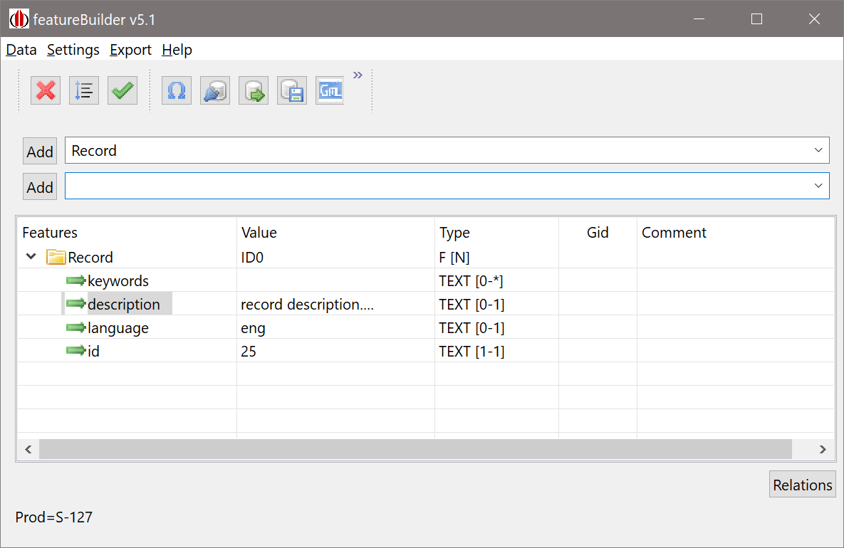
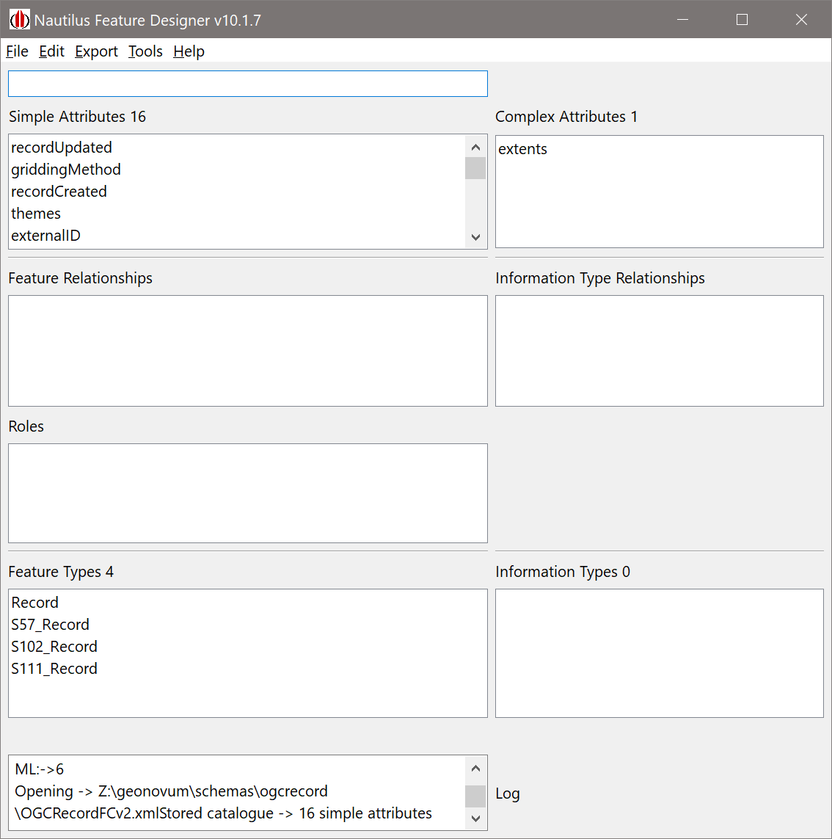
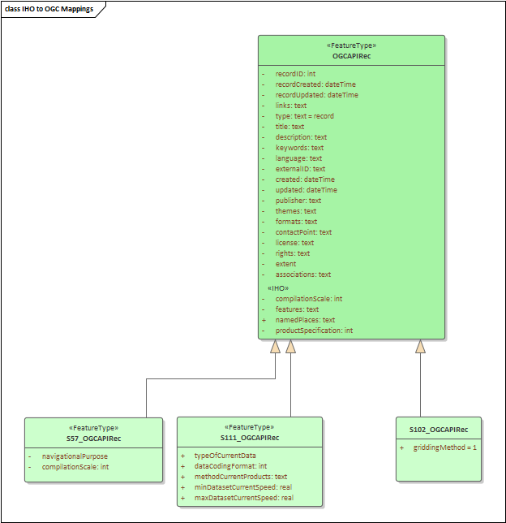
= derived from
<S100FC:name>OGCRecordsFC</S100FC:name> <S100FC:scope>global</S100FC:scope> <S100FC:fieldOfApplication>none</S100FC:fieldOfApplication> <S100FC:versionNumber>0.0</S100FC:versionNumber> <S100FC:versionDate>2021-10-29+01:00</S100FC:versionDate> <S100FC:producer> <S100CI:role>author</S100CI:role> <S100CI:party> <S100CI:CI_Organisation> <S100CI:name>None</S100CI:name> <S100CI:contactInfo> <S100CI:address> <S100CI:city>Frome</S100CI:city> <S100CI:administrativeArea>Somerset</S100CI:administrativeArea> <S100CI:country>UK</S100CI:country> <S100CI:electronicMailAddress>jp@jpsworldoffun.com</S100CI:electronicMailAddress> </S100CI:address> <S100CI:onlineResource> <S100CI:linkage>www.iictechnologies.com</S100CI:linkage> </S100CI:onlineResource> </S100CI:contactInfo> </S100CI:CI_Organisation> </S100CI:party> </S100FC:producer> <S100FC:classification>unclassified</S100FC:classification> <S100FC:S100_FC_SimpleAttributes> <S100FC:S100_FC_SimpleAttribute> <S100FC:name>recordUpdated</S100FC:name> <S100FC:definition>recordUpdated</S100FC:definition> <S100FC:code>recordUpdated</S100FC:code> <S100FC:alias></S100FC:alias> <S100FC:valueType>dateTime</S100FC:valueType> </S100FC:S100_FC_SimpleAttribute> <S100FC:S100_FC_SimpleAttribute> <S100FC:name>griddingMethod</S100FC:name> <S100FC:definition>griddingMethod, used for S-102 grid data</S100FC:definition> <S100FC:code>griddingMethod</S100FC:code> <S100FC:alias></S100FC:alias> <S100FC:valueType>enumeration</S100FC:valueType> <S100FC:listedValues> <S100FC:listedValue> <S100FC:label>historicalObservation</S100FC:label> <S100FC:definition>historicalObservation - from S-102 Product Specifcation</S100FC:definition> <S100FC:code>1</S100FC:code> </S100FC:listedValue> <S100FC:listedValue> <S100FC:label>realtimeObservation</S100FC:label> <S100FC:definition>realtimeObservation</S100FC:definition> <S100FC:code>2</S100FC:code> </S100FC:listedValue>
geoj.append(",\"geometry\": { \"type\": \"Polygon\", \"coordinates\": [[["). append(wlon).append(",").append(nlat).append(" ] "). append(", [").append(elon).append(" , ").append(nlat).append("] , ["). append(elon).append(" , ").append(slat).append("], ["). append(wlon).append(" , ").append(slat).append("], ["). append(wlon).append(",").append(nlat). append("]]]}"); geomap.put(nm , geoj.toString()); geo = "st_geomfromtext('" + geo + "')"; geo = "st_setsrid(" + geo + ",4326)"; String stmt2 = " values(" + "'" + nm + "'," + "'" + base_isdt + "'," + edtn + "," + "'" + upd + "'," + updn + "," + sz + "," + geoj.toString() + "," + u + ")"; int t = T.getNextFeatureID(); ArrayList<treenod2> nds = new ArrayList<treenod2>(){ { add(new treenod2(1, 0, 0, t, "typeOfProductFormat", "ISO/IEC 8211", "sA")); add(new treenod2(2, 0, 0, t, "chartNumber", nm, "sA")); add(new treenod2(3, 0, 0, t, "compilationScale", "45000", "sA")); add(new treenod2(4, 0, 0, t, "producerCode", nm.substring(0, 2), "sA")); add(new treenod2(5, 0, 0, t, "copyright", "not applicable", "sA")); add(new treenod2(6, 0, 0, t, "editionDate", "2019-04-05", "sA")); add(new treenod2(7, 0, 0, t, "editionNumber", edtn, "sA")); add(new treenod2(8, 0, 0, t, "issueDate", mbase_isdt, "sA")); add(new treenod2(9, 0, 0, t, "productType", "ENC", "sA")); //add(new treenod2(10, 0, 0, t, "specificUsage", "approach", "sA")); add(new treenod2(1,0,0,t,"recordCreated","2021-10-30","sA")); add(new treenod2(3,0,0,t,"type","ENC Chart","sA")); add(new treenod2(4,0,0,t,"title",nm,"sA")); add(new treenod2(5,0,0,t,"description","Auto-generated description","sA")); add(new treenod2(6,0,0,t,"contactPoint","NOAA, US","sA")); add(new treenod2(7,0,0,t,"externalId","ENC_"+nm,"sA")); add(new treenod2(8,0,0,t,"themes","oceans","sA")); add(new treenod2(9,0,0,t,"themes","navigation","sA")); add(new treenod2(10,0,0,t,"_metadata-anytext","7e46_"+nm,"sA")); }}; nds.add(new treenod2(11,0,0,t,"recordUpdated",upd,"sA")); nds.add(new treenod2(12,0,0,t,"updateNumber",updn,"sA")); this.T.addFeature("Record", nds,nm,ftyp.FEATURE_TYPE, Prim.SURFACE,"GID_"+nm);
Metadata
data
(metadata)
Feature Catalogue
Metadata
Model

Slide 5
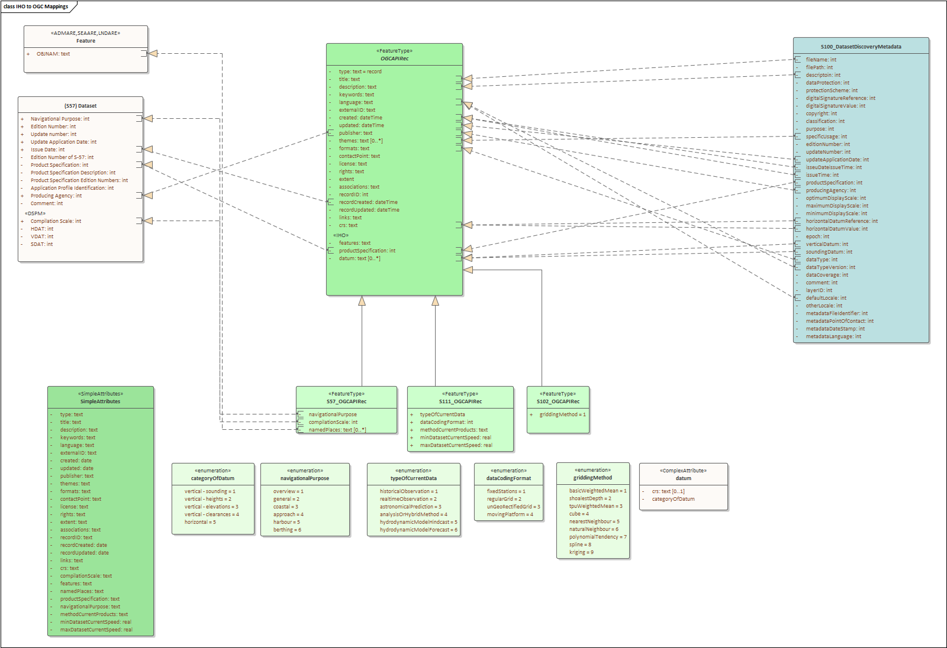
IHO charts
OGC API Record
mapping….
IHO S-100 Metadata
Bespoke Extensions per product, Chart, Surface Currents

Slide 6
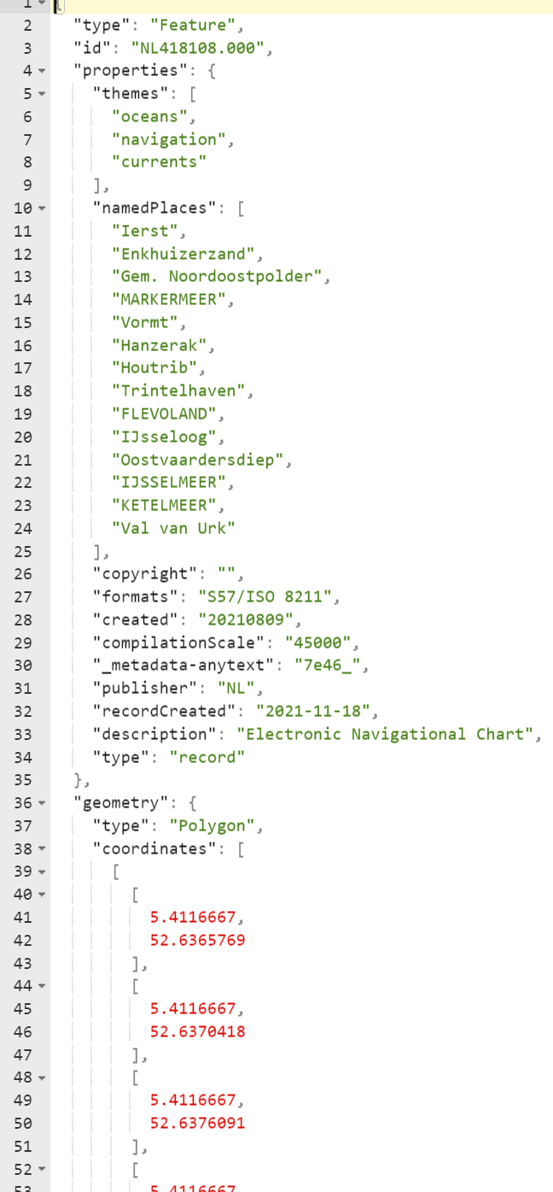
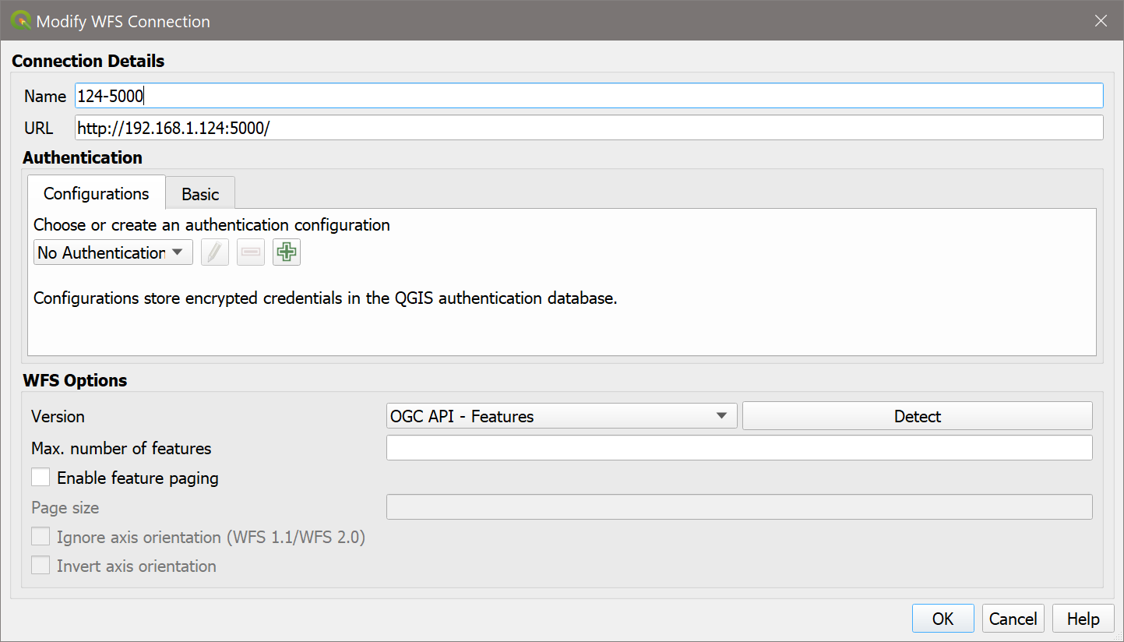
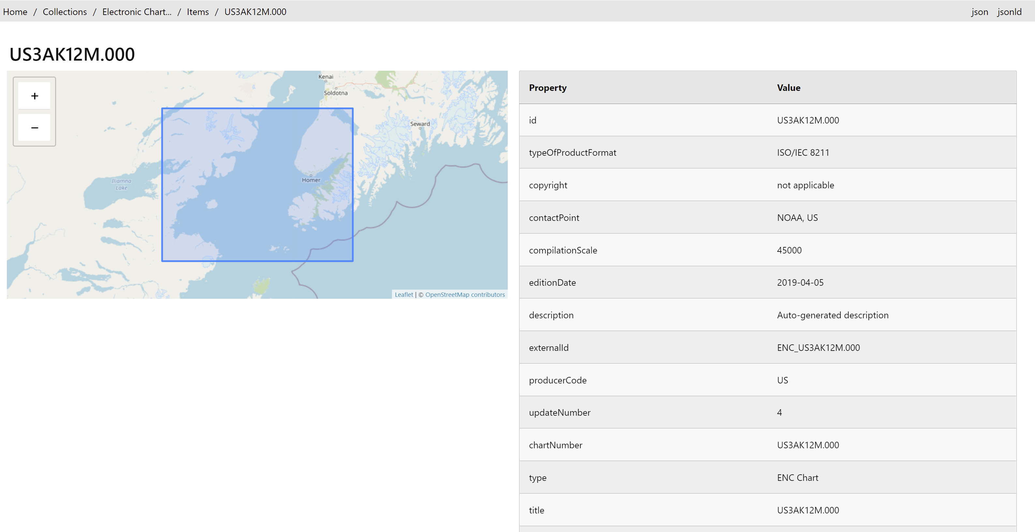
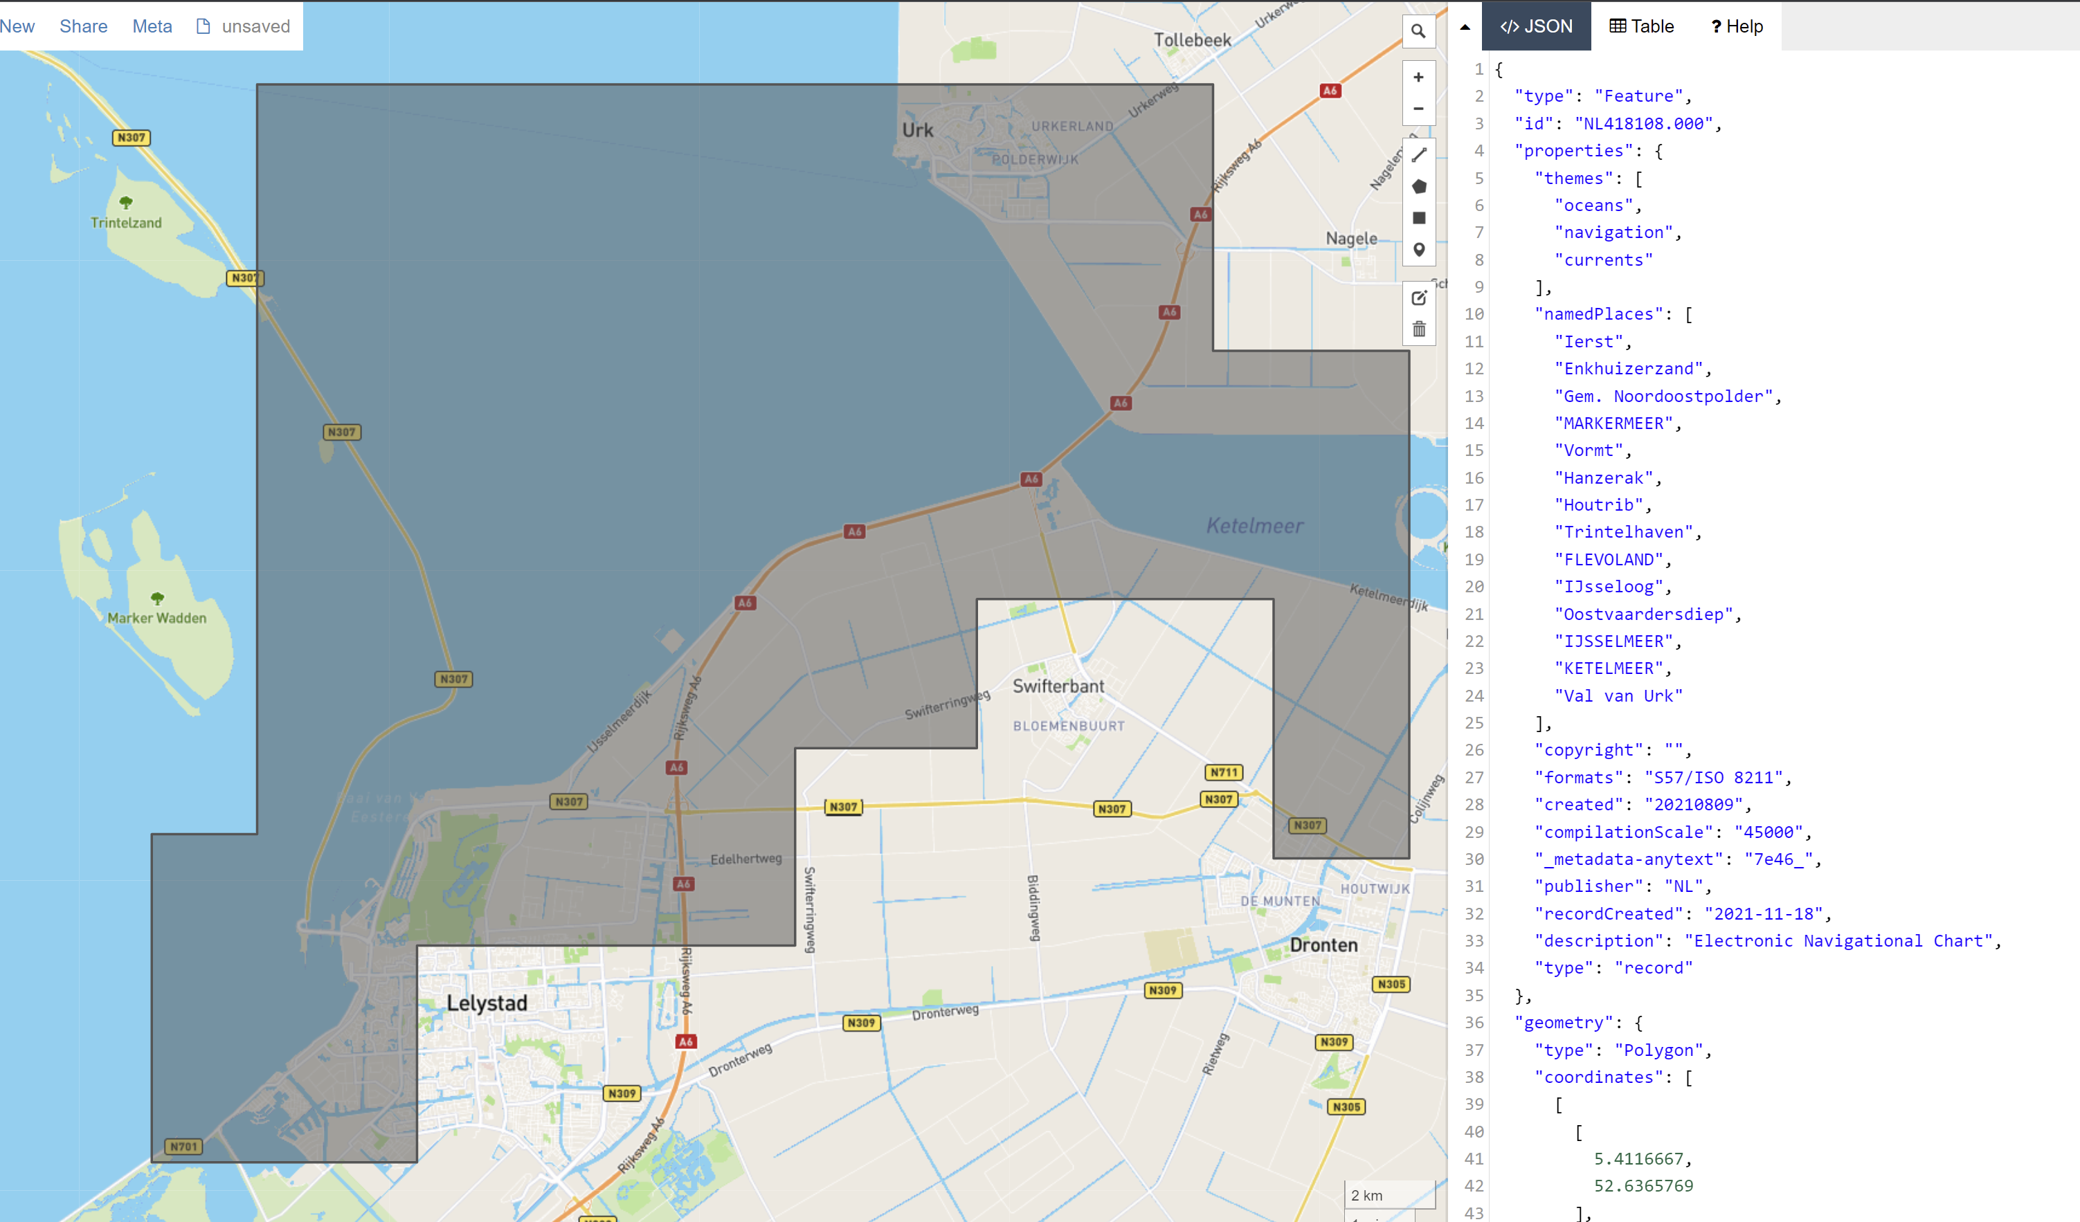
The “pipeline”…
S100DB
ENC data
(s-57 for now)
Extract Fields
Make OGC Records “feature”
(map fields)
GeoJSON
output
tinyDB Catalogue
String description = "Electronic Navigational Chart " + c.comt; String nm = c.dsnm; String usage = nm.substring(2,3); nds = new ArrayList<treenod2>() { { add(new treenod2(4, 0, 0, t, "publisher", party, "sA")); add(new treenod2(5, 0, 0, t, "copyright", copyright, "sA")); add(new treenod2(6, 0, 0, t, "created", created, "sA")); add(new treenod2(7, 0, 0, t, "updated", created, "sA")); add(new treenod2(9, 0, 0, t, "formats", dataType, "sA")); add(new treenod2(11, 0, 0, t, "specificUsage", fromUsage(usage), "sA")); add(new treenod2(1, 0, 0, t, "recordCreated", "2021-11-18", "sA")); add(new treenod2(3, 0, 0, t, "type", "record", "sA")); add(new treenod2(2,0,0,t,"title",nm,"sA")); add(new treenod2(8, 0, 0, t, "description", description, "sA")); // add(new treenod2(7,0,0,t,"externalId","ENC_"+nm,"sA")); add(new treenod2(9,0,0,t,"themes","oceans","sA")); add(new treenod2(10,0,0,t,"themes","navigation","sA")); add(new treenod2(12,0,0,t,"themes","currents","sA")); if (o.atts !=null && o.atts.containsKey("OBJNAM")) { String v = o.atts.get("OBJNAM"); System.out.println("Place=>" + v); if (o.obj.compareTo("LNDARE")==0 || o.obj.compareTo("SEAARE")==0 || o.obj.compareTo("ADMARE")==0) { places.add(v); } }
OGC API Records
Feature Catalogue
pygeoAPI
(Records)

Slide 7
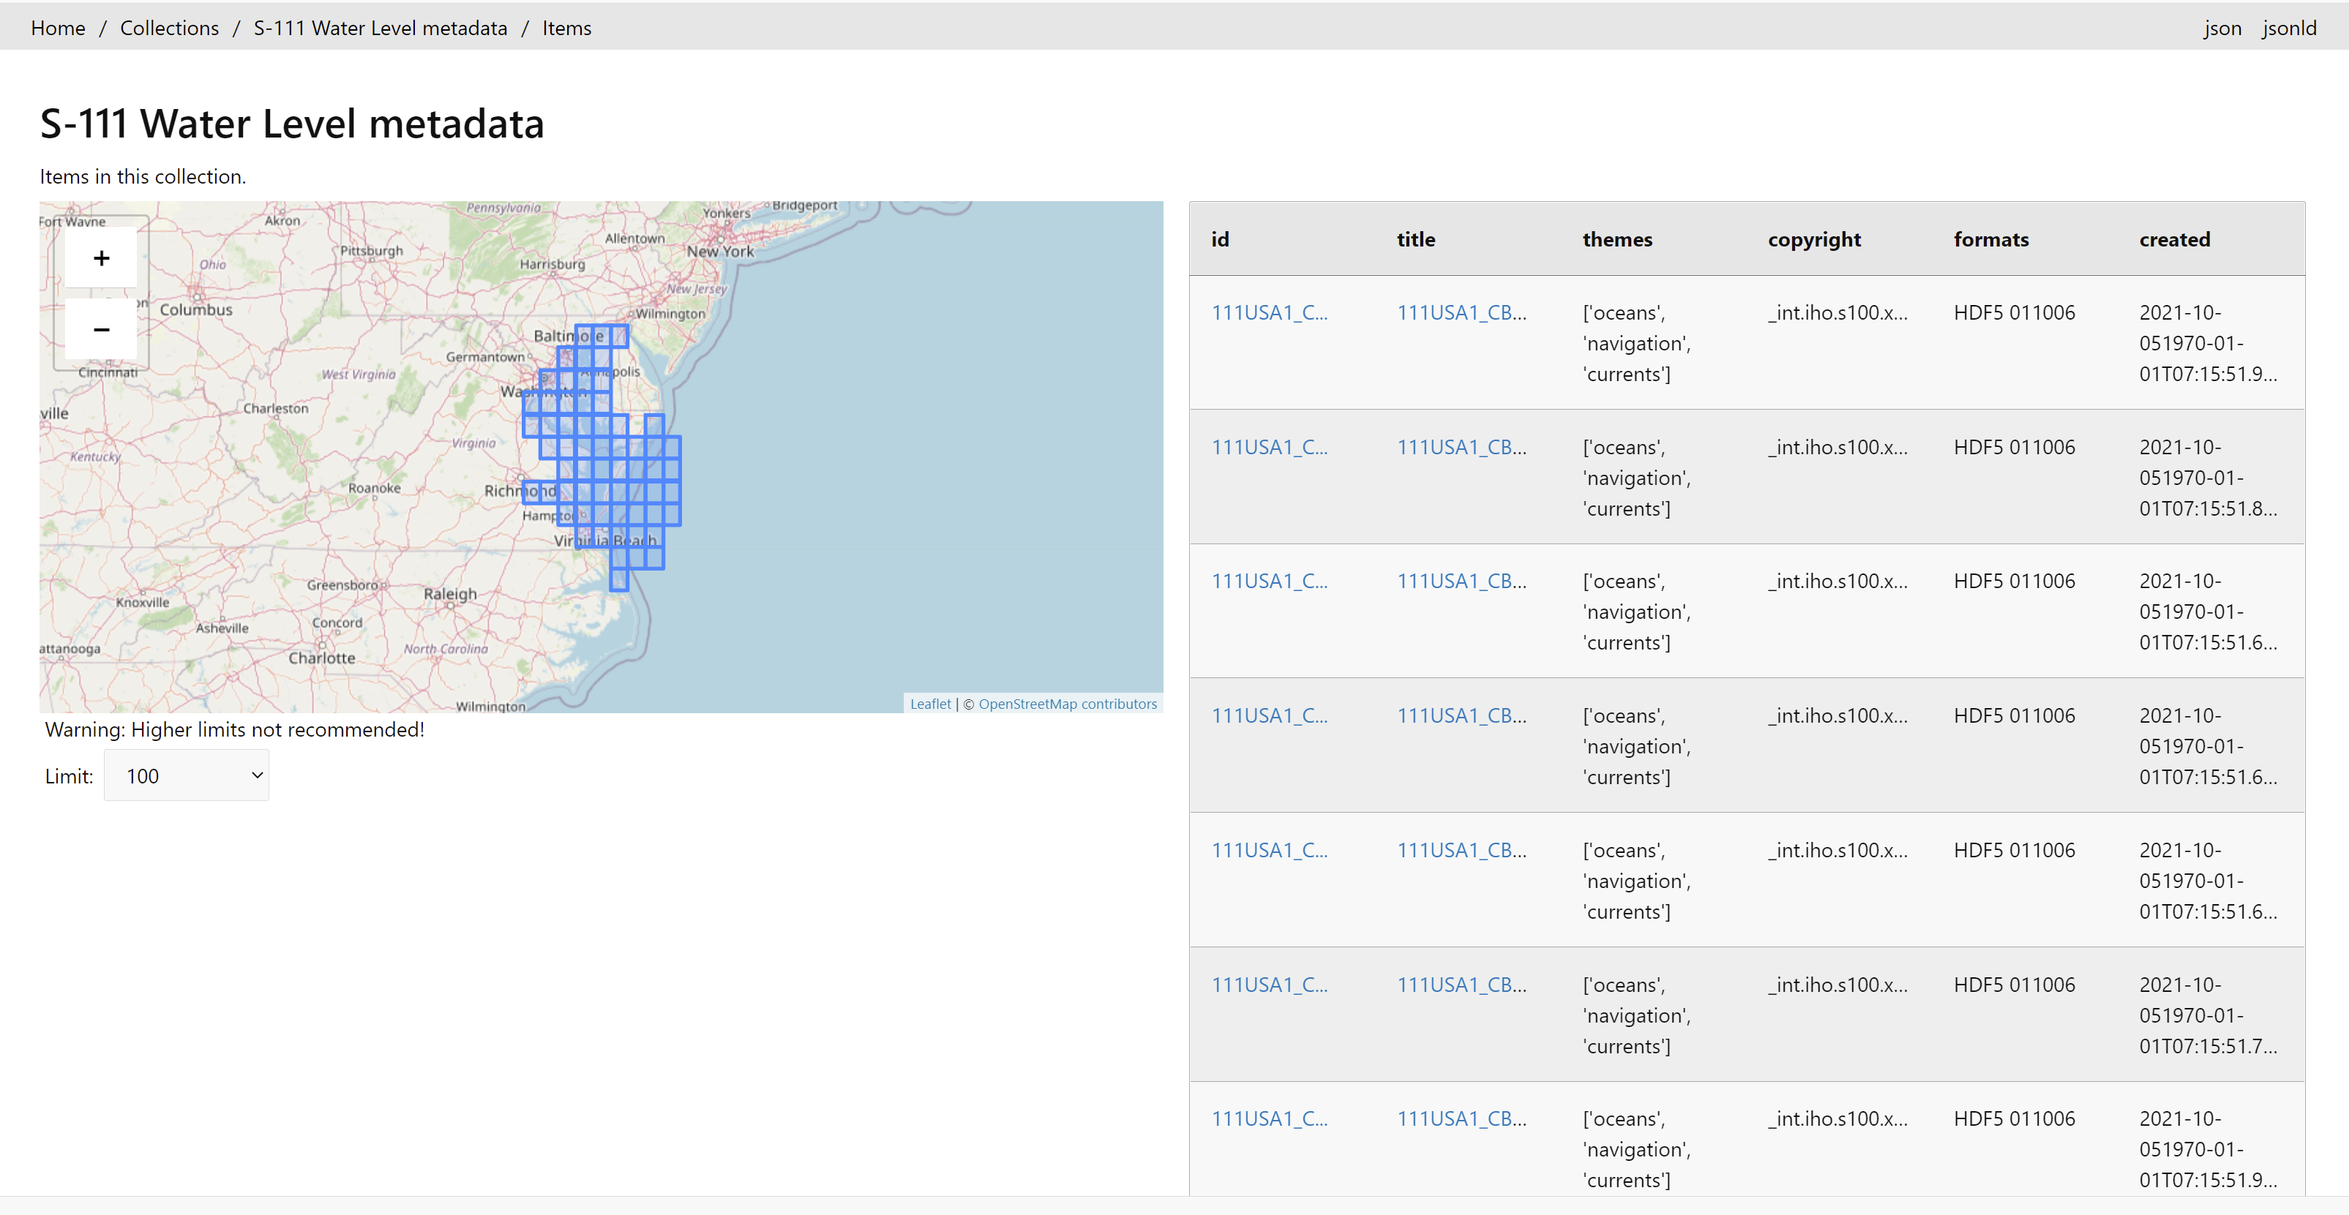
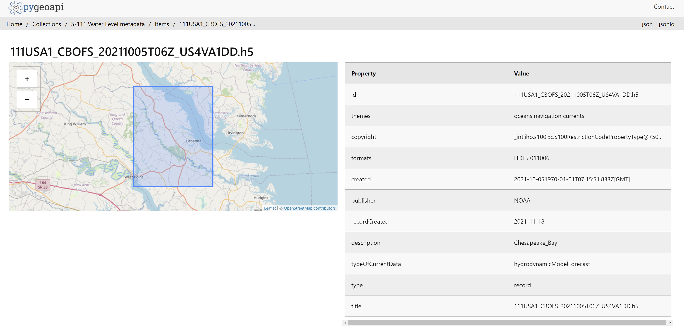

Slide 8
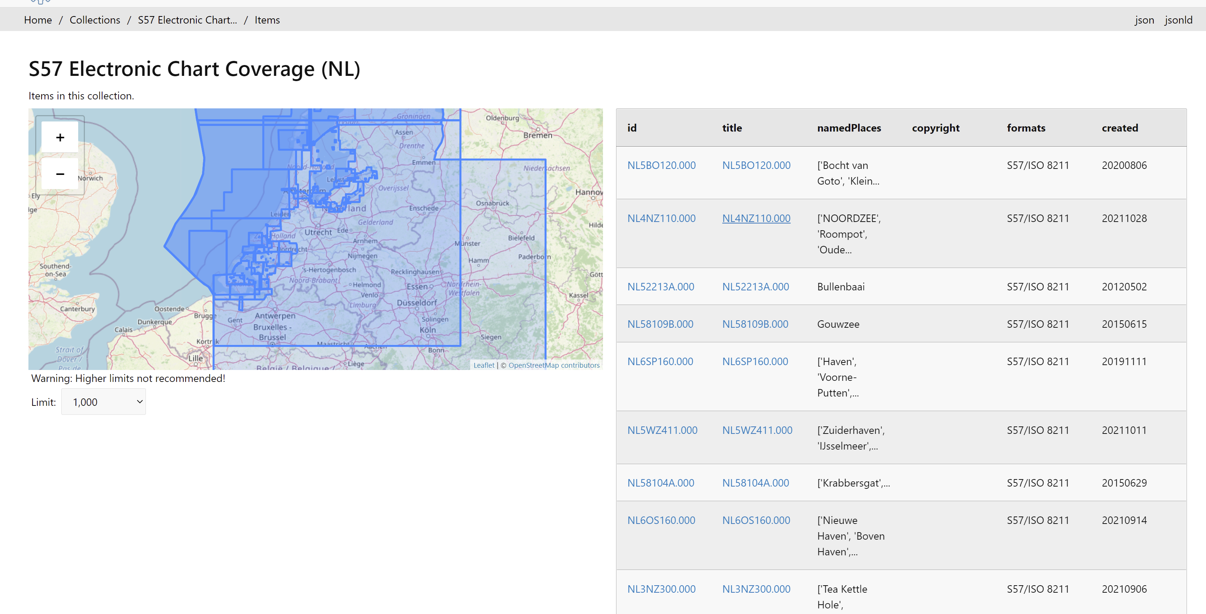
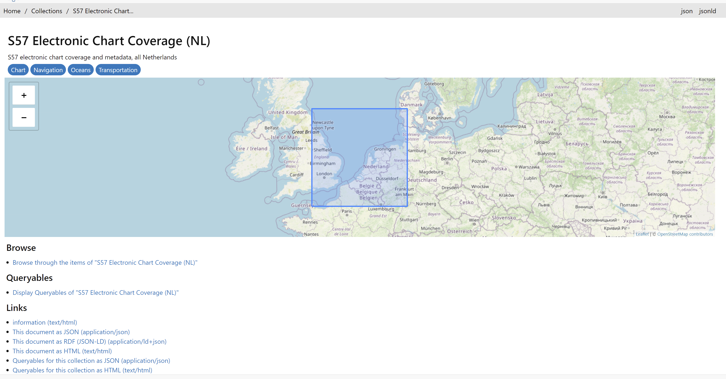
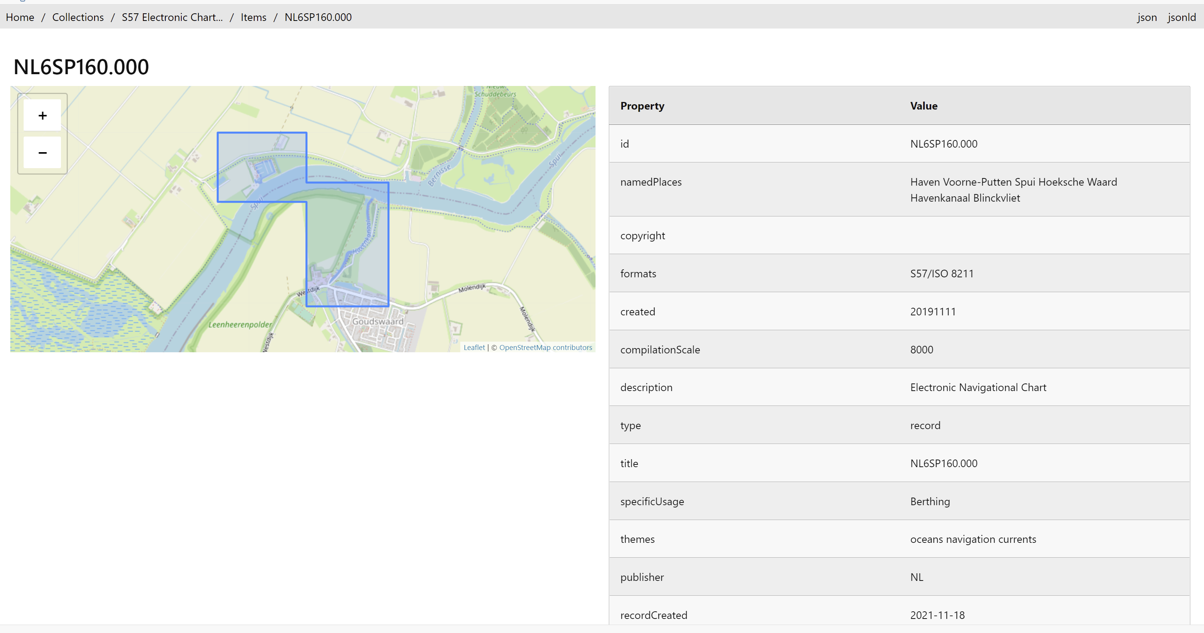

Slide 9
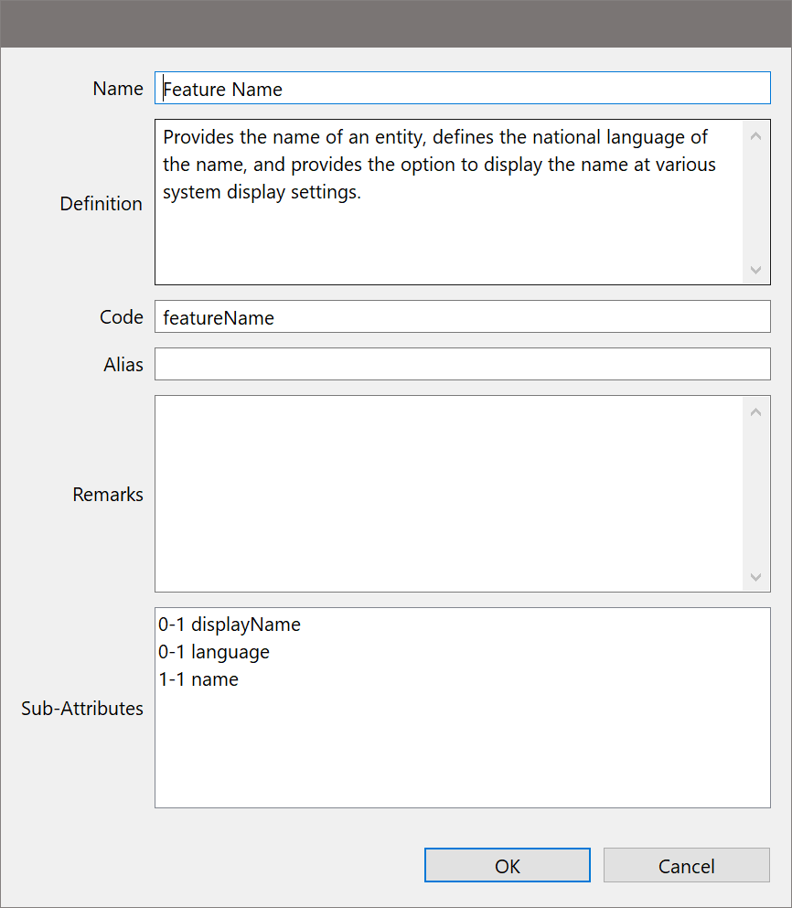
Best Practice 1: Use globally unique persistent HTTP URIs for Spatial Things
Best Practice 2: Make your spatial data indexable by search engines
SDWBP : 8.2 Provide metadata for both human users and computer applications.
Publish a HTML Web-page for the spatial dataset and each Spatial Thing that it describes
Make sure that those pages can be crawled.
Fill out metadata fields
Keep titles < 60 characters
Optimise Abstracts
Don’t include lists of keywords
Influence the URL
Keep the same URL when updated
Remove Out of Date Pages
Avoid Duplication
Use tools and tests
Implement for all pages
Descriptive
We’re not good at this (currently)
Structural
We’re very good at this ☺.

Slide 10
Best Practice 1: Use globally unique persistent HTTP URIs for Spatial Things
Best Practice 2: Make your spatial data indexable by search engines
SDWBP : 8.2 Provide metadata for both human users and computer applications.
Publish a HTML Web-page for the spatial dataset and each Spatial Thing that it describes
Make sure that those pages can be crawled.
/collections/ENC/items/NL6SP160.000
Fill out metadata fields
Keep titles < 60 characters
Optimise Abstracts
Don’t include lists of keywords
Influence the URL
Keep the same URL when updated
Remove Out of Date Pages
Avoid Duplication
Use tools and tests
Implement for all pages
“Named Places” and themes
“updated” can be edited or adjusted based on ENC update issue date. Same record.
One record per dataset – no duplication

Slide 11
